Slide 2
Statistics!!!!

Slide 3

Statistics!!!!

Slide 4

Statistics!!!!

Slide 5

Statistics!!!!

Slide 6

Statistics!!!!

Slide 7
Ok.
Statistics!!!!

Slide 8

Statistics

Slide 9

Statistics

Slide 10
Ok.
Statistics

Slide 11
Statistics

Slide 12
Statistics = collecting and analyzing numbers so we can make assumptions about other numbers.
Inferential Statistics

Slide 13
Statistics = collecting and analyzing numbers so we can make assumptions about other numbers.
Inferential Statistics = using numbers to make inferences (assumptions) about other numbers

Slide 15
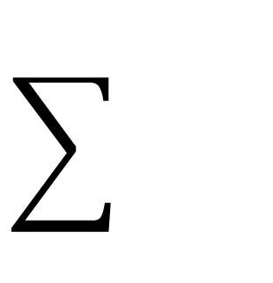
Summation

Slide 16
Summation

Slide 17

Summation

Slide 18
Summation

Slide 19
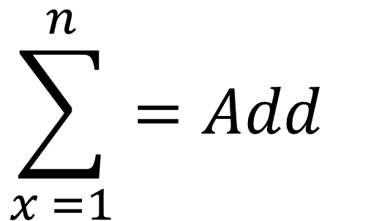
Summation
$$\sum_{x =1}^{n}{{=Add}_{}}$$

Slide 20
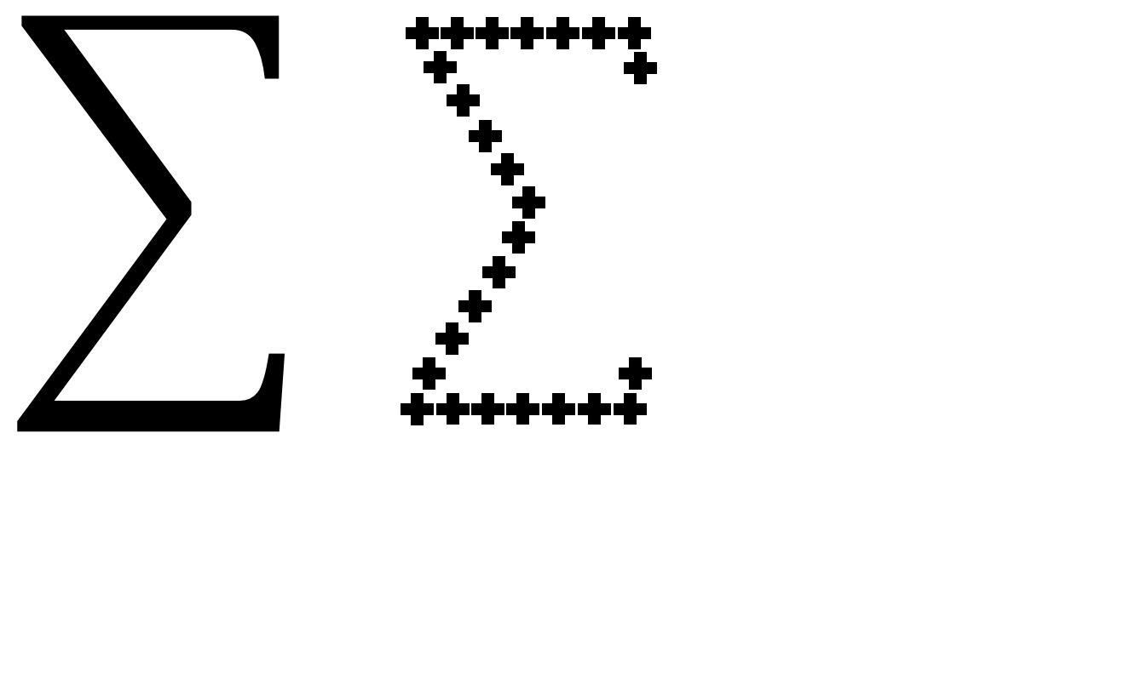
Summation
=

Slide 21
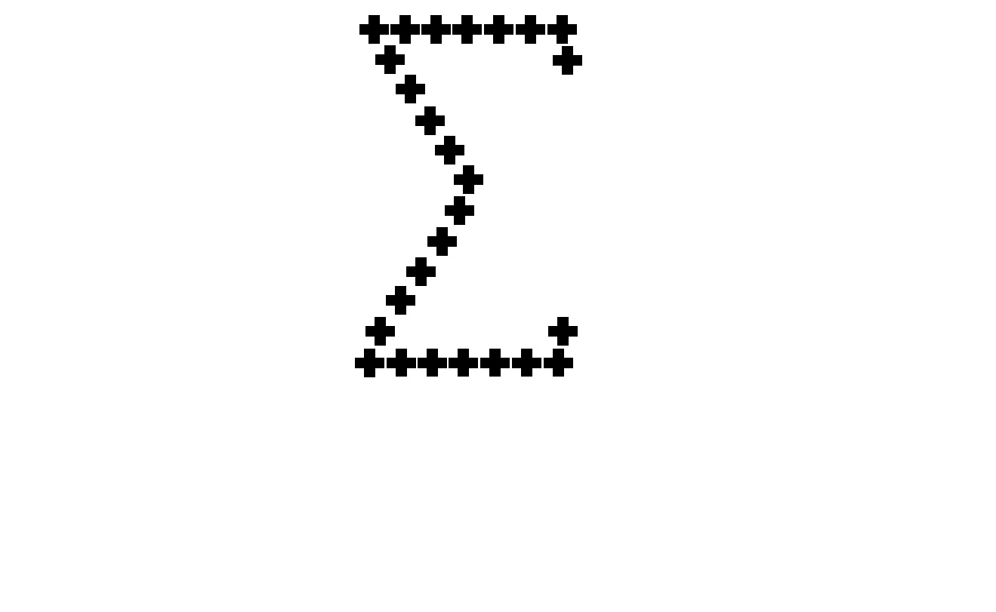

$$\sum_{x=1}^{n}{x_{i}}$$
Finish
Rule
Start

Slide 22
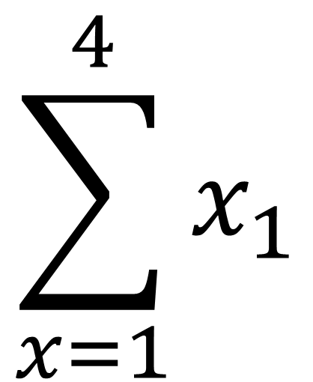
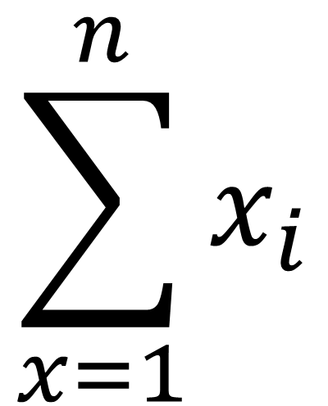
Finish
Finish
$$\sum_{x=1}^{n}{x_{i}}$$
$$\sum_{x=1}^{4}{x_{1}}$$
Rule
Rule
Start
Start

Slide 23
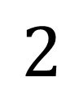
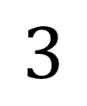
Finish
Finish
$$\sum_{x=1}^{n}{x_{i}}$$
$$\sum_{x=1}^{4}{x_{1}}$$
$$3$$
Rule
Rule
$$2$$
Start
Start

Slide 24
Finish
Finish
$$\sum_{x=1}^{n}{x_{i}}$$
$$\sum_{x=1}^{4}{x_{1}}$$
$$3$$
Rule
Rule
$$2$$
Start
Start
1 + 2 + 3 + 4 = 10

Slide 25
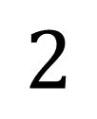
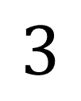
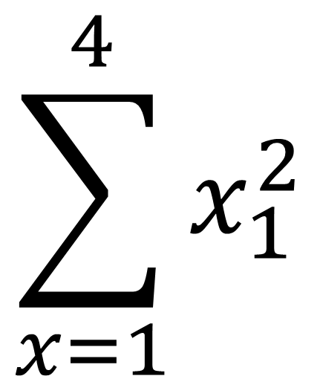
Finish
Finish
Finish
$$\sum_{x=1}^{n}{x_{i}}$$
$$\sum_{x=1}^{4}{x_{1}}$$
$$\sum_{x=1}^{4}{x_{1}^{2}}$$
$$3$$
Rule
Rule
Rule
$$2$$
Start
Start
Start
$1^{2}$ + $2^{2}$ + $3^{2}$ + $4^{2}$ = 1 + 4 + 9 + 16 = 30

Slide 27
N = Number
n = number

Slide 28
N = Number
n = number
Total Number
partial number

Slide 29
N = Number
n = number
Population
Total Number
sample of the population
partial number

Slide 30
Population
sample
N = Number
n = number
Total Number
partial number

Slide 31
Population
sample
N = Number
n = number
Total Number
partial number
N = 30

Slide 32
Population
sample
N = Number
n = number
Total Number
partial number
N = 30

Slide 33
Population
sample
N = Number
n = number
Total Number
partial number
N = 30
n = 10

Slide 34
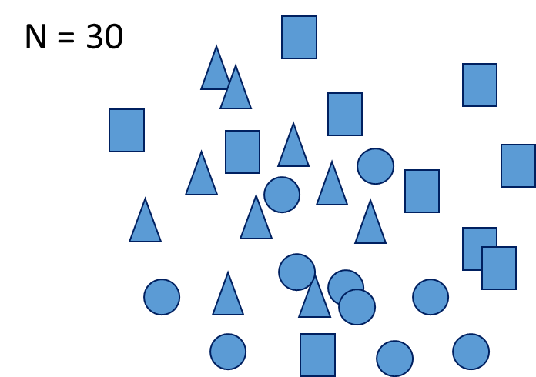
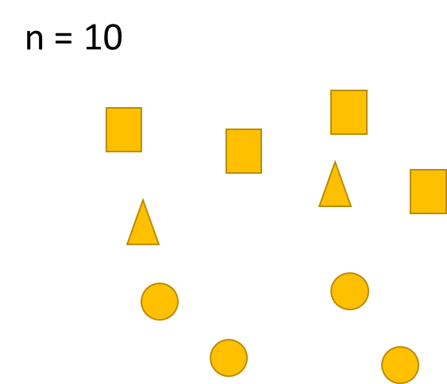
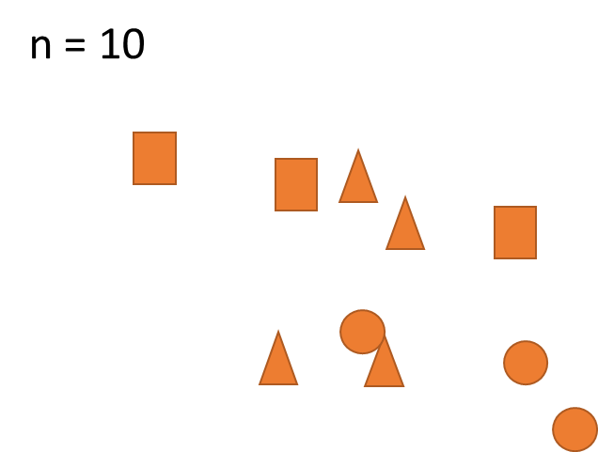
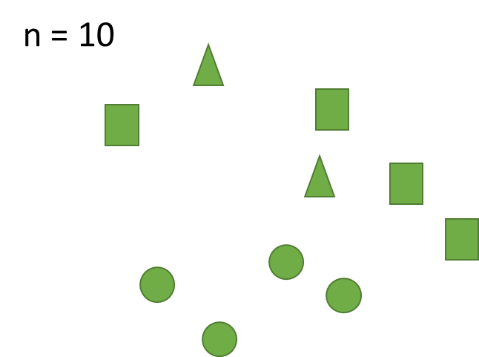
Random Sampling

Slide 35



Slide 36

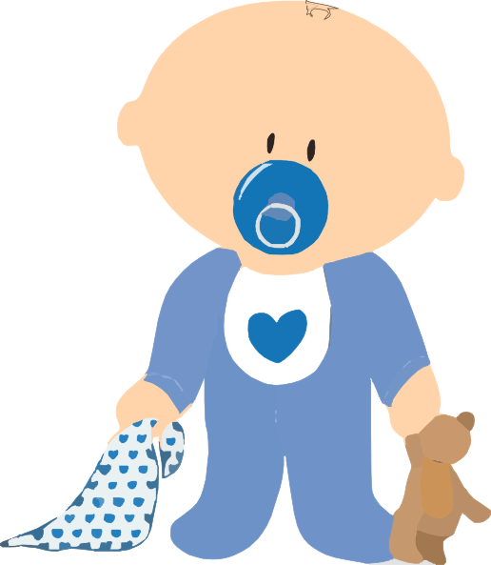
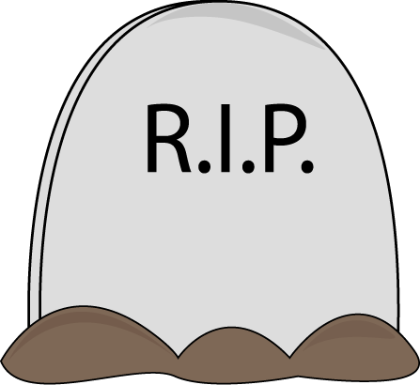
7,000,000,000
350,000 per day
150,000 per day

Slide 37
Measures of Central Tendency
A single value that attempts to describe a set of data by identifying the central position within that set of data.
It is there to represent
It is the “middleness”
Mean Average
Median Middle score when arranged from low to high or high to low
Mode Most frequently occurring

Slide 38
Mean = Average

Slide 39
Mean = Average = Typical representation of something

Slide 40
X µ
Mean = Average = Typical representation of something

Slide 41
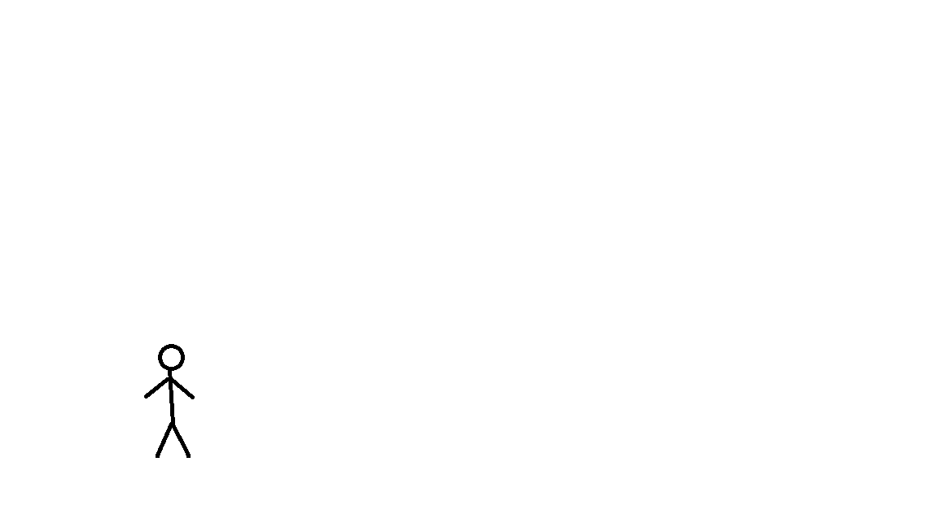
X µ
Mean = Average = Typical representation of something

Slide 42
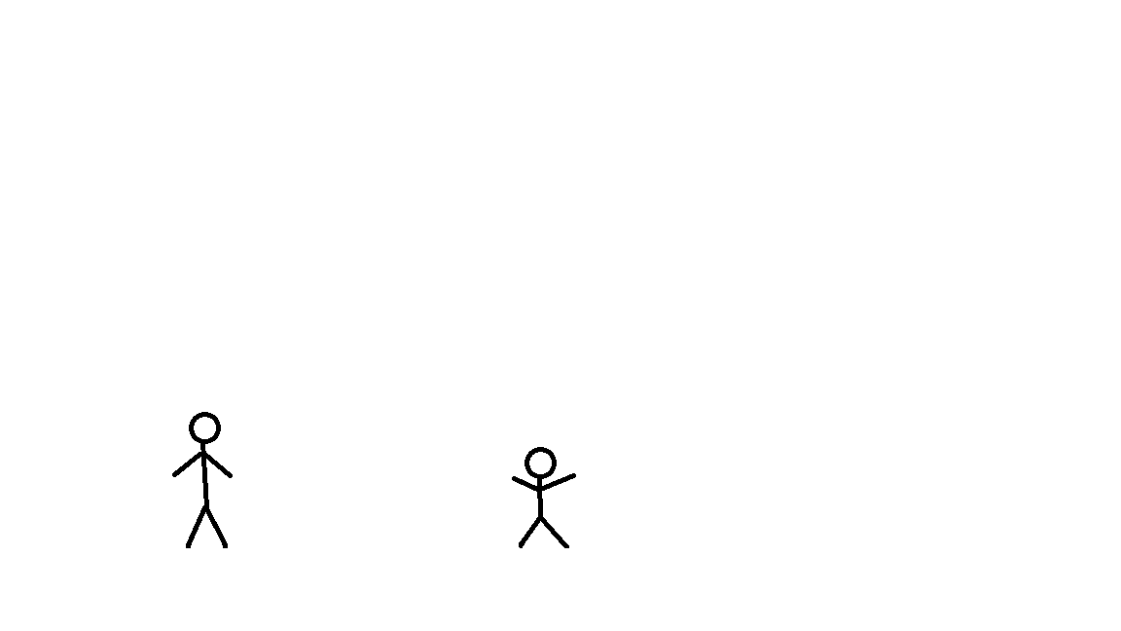
X µ
Mean = Average = Typical representation of something

Slide 43
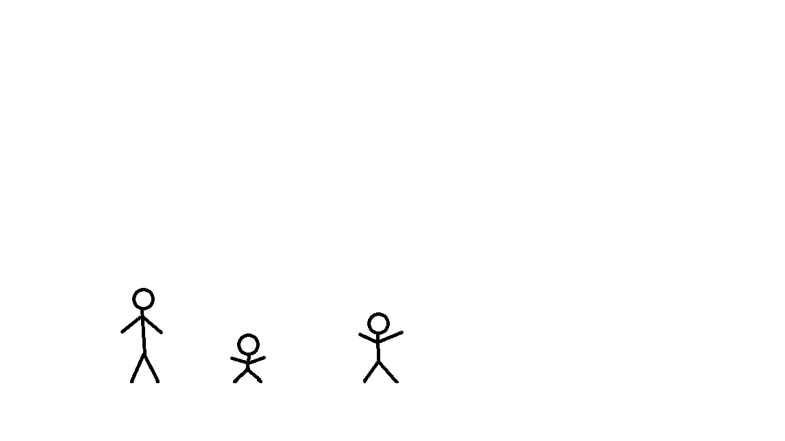
X µ
Mean = Average = Typical representation of something

Slide 44
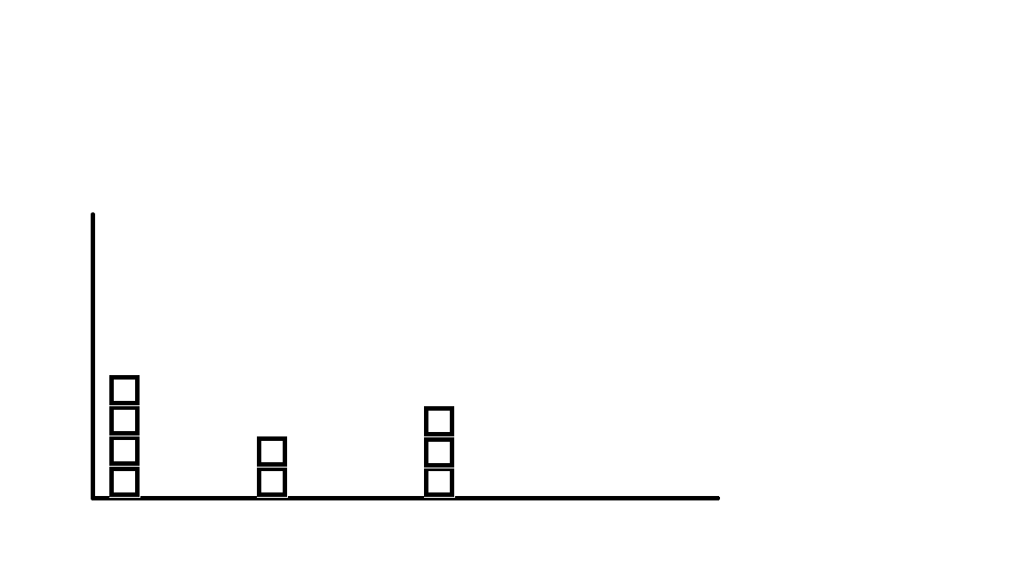

Slide 45
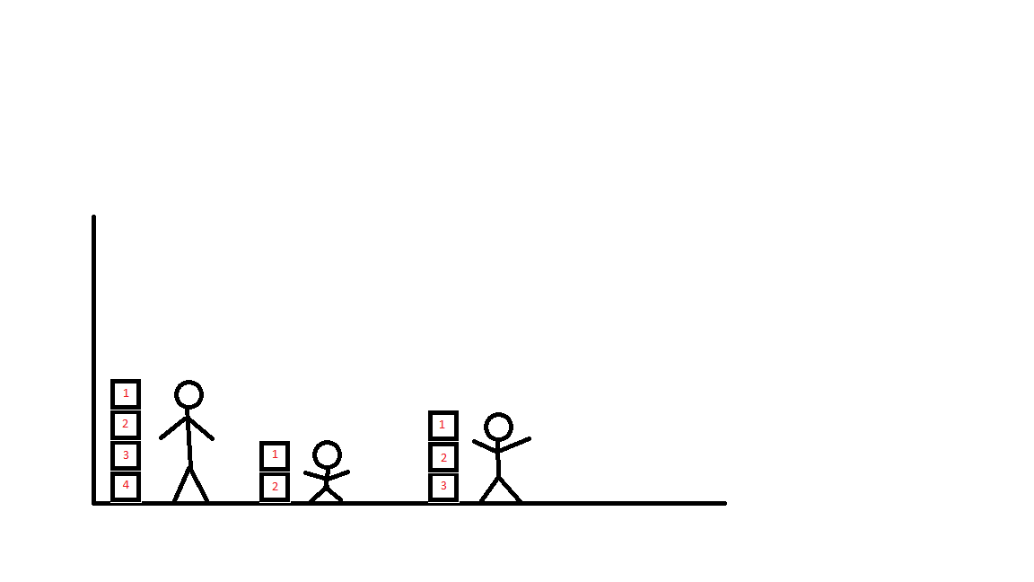
1 2 3

Slide 46
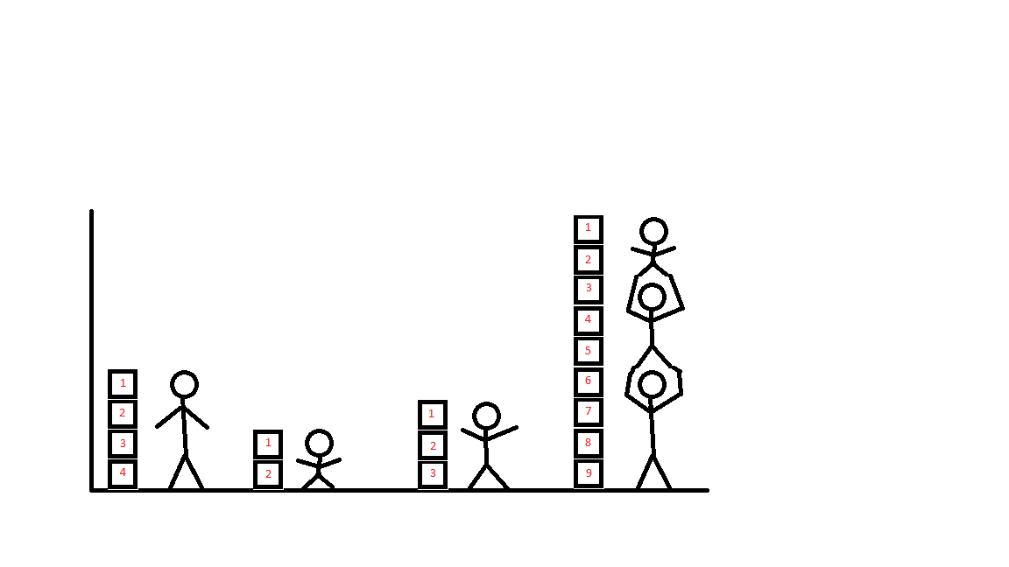
1 2 3

Slide 47
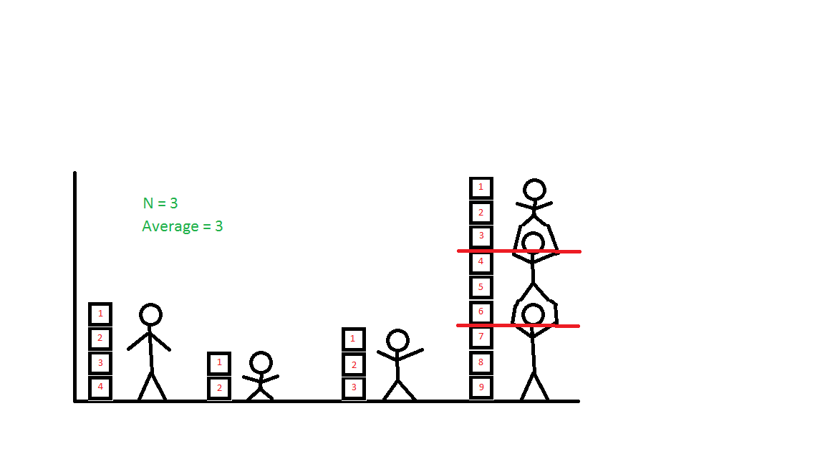
N = 3
= 3
Number
x
Average
1 2 3

Slide 48
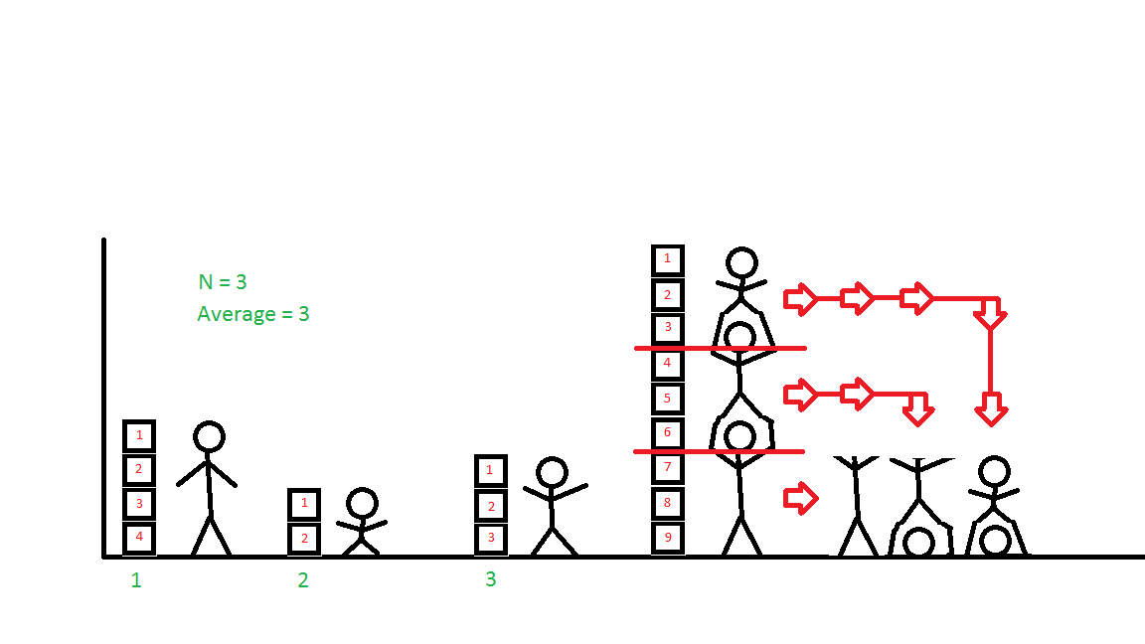
N = 3
= 3
Number
x
Average
1 2 3

Slide 49
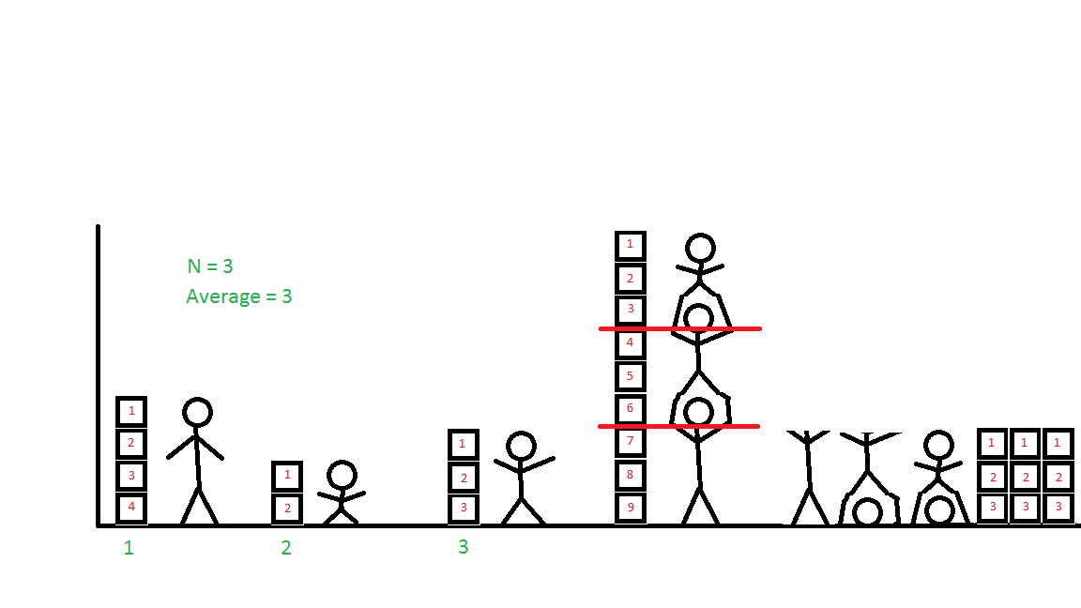
N = 3
= 3
Number
x
Average
1 2 3

Slide 50
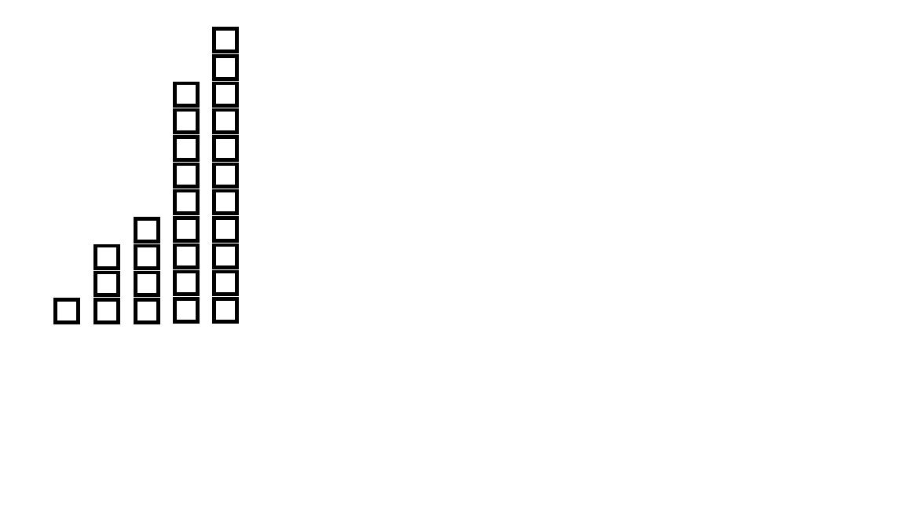

Slide 51
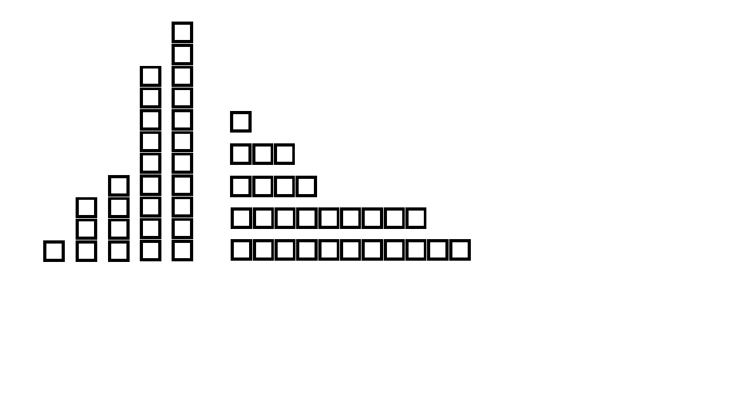

Slide 52
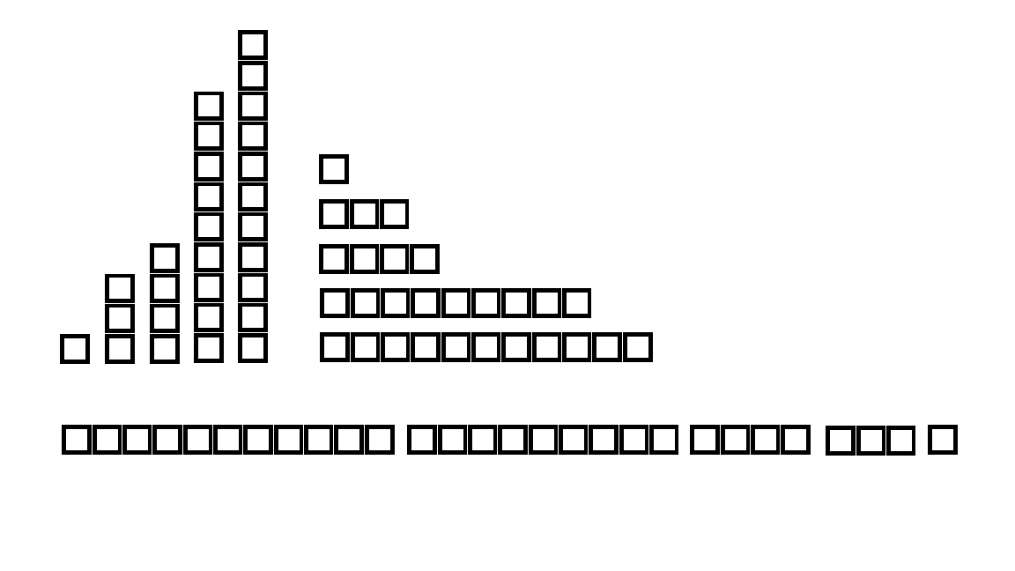

Slide 53
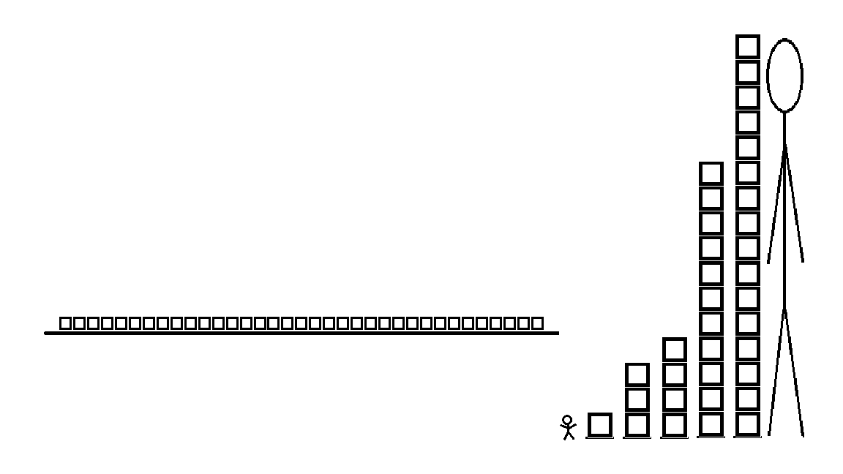
N = 5
0 1 2 3 4 5 6 7 8 9 10 11 12 13 14 15 16 17 18 19 20 21 22 23 24 25 26 27 28 29 30 31 32 33 34 35

Slide 54
(16)
N = 5
X = { 1, 3, 4, 11, 16 }
16
15
14
13
12
11
10
9
8
7
6
5
4
3
2
1
0
(11)
Height
(4)
0 1 2 3 4 5 6 7 8 9 10 11 12 13 14 15 16 17 18 19 20 21 22 23 24 25 26 27 28 29 30 31 32 33 34 35
(3)
(1)
1 2 3 4 5
Merna’s

Slide 55
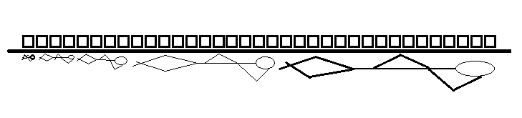
(16)
N = 5
X = { 1, 3, 4, 11, 16 }
16
15
14
13
12
11
10
9
8
7
6
5
4
3
2
1
0
(11)
Height
(4)
0 1 2 3 4 5 6 7 8 9 10 11 12 13 14 15 16 17 18 19 20 21 22 23 24 25 26 27 28 29 30 31 32 33 34 35
(3)
(1)
1 2 3 4 5
Merna’s

Slide 56
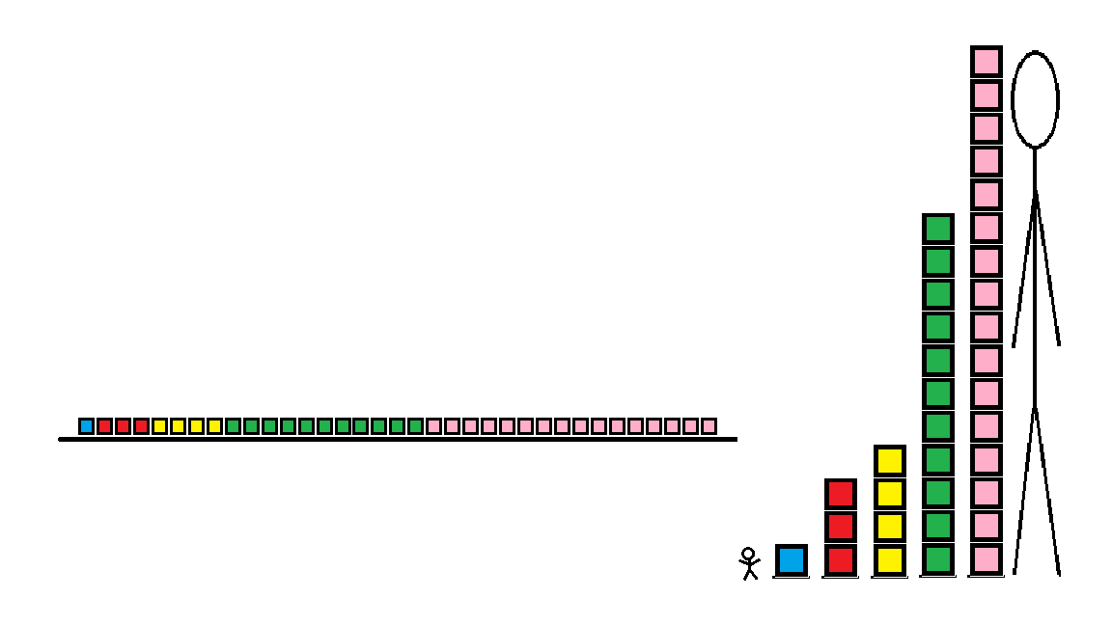
(16)
N = 5
X = { 1, 3, 4, 11, 16 }
16
15
14
13
12
11
10
9
8
7
6
5
4
3
2
1
0
(11)
Height
(4)
0 1 2 3 4 5 6 7 8 9 10 11 12 13 14 15 16 17 18 19 20 21 22 23 24 25 26 27 28 29 30 31 32 33 34 35
(3)
(1)
1 2 3 4 5
Merna’s

Slide 57
(16)
N = 5
X = { 1, 3, 4, 11, 16 }
∑ (1 + 3 + 4 + 11 + 16) = 35
16
15
14
13
12
11
10
9
8
7
6
5
4
3
2
1
0
(11)
Height
1 2 3 4 5
(4)
0 1 2 3 4 5 6 7 8 9 10 11 12 13 14 15 16 17 18 19 20 21 22 23 24 25 26 27 28 29 30 31 32 33 34 35
(3)
(1)
1 2 3 4 5
Merna’s

Slide 58
(16)
N = 5
X = { 1, 3, 4, 11, 16 }
∑ (1 + 3 + 4 + 11 + 16) = 35
16
15
14
13
12
11
10
9
8
7
6
5
4
3
2
1
0
x
Average
= 1 + 3 + 4 +11 + 16
5
35
5
=
=
7
(11)
Height
7
1 2 3 4 5
(4)
0 1 2 3 4 5 6 7 8 9 10 11 12 13 14 15 16 17 18 19 20 21 22 23 24 25 26 27 28 29 30 31 32 33 34 35
(3)
(1)
1 2 3 4 5
Merna’s

Slide 59
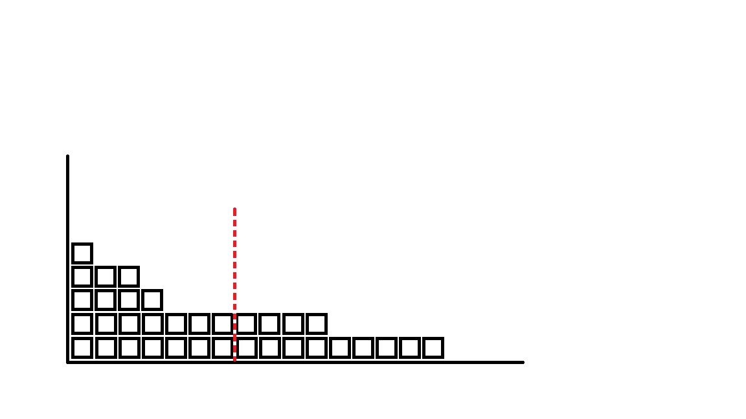
(16)
N = 5
X = { 1, 3, 4, 11, 16 }
Average = 1 + 3 + 4 +11 + 16
5
Average is the typical representation of the group.
N = 5
X = { 1, 3, 4, 11, 16 }
Mean Average Middle = 7
x
35
5
=
=
7
(11)
1 2 3 4 5
(4)
0 1 2 3 4 5 6 7 8 9 10 11 12 13 14 15 16 17 18 19 20 21 22 23 24 25 26 27 28 29 30 31 32 33 34 35
(3)
(1)
0 1 2 3 4 5 6 7 8 9 10 11 12 13 14 15 16
1 2 3 4 5

Slide 60
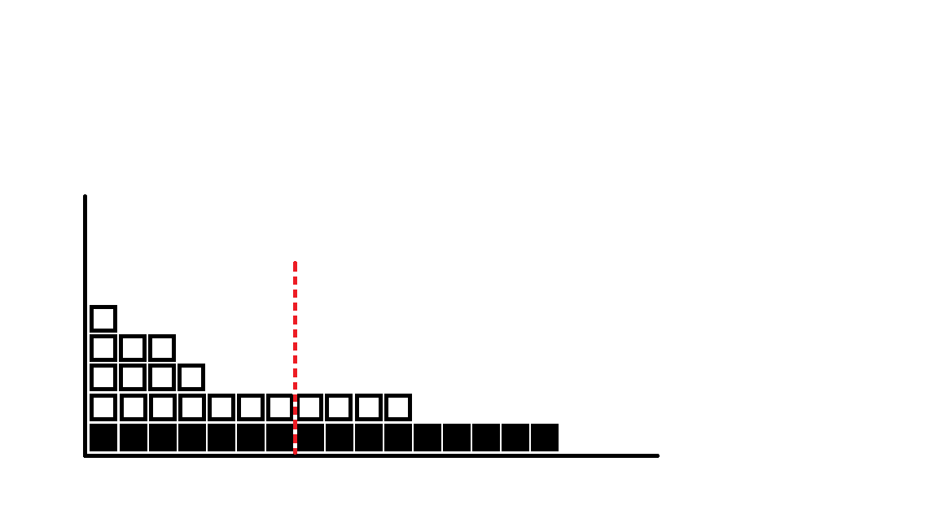
(16)
N = 5
X = { 1, 3, 4, 11, 16 }
Average = 1 + 3 + 4 +11 + 16
5
Average is the typical representation of the group.
N = 5
X = { 1, 3, 4, 11, 16 }
Mean Average Middle = 7
x
35
5
=
=
7
(11)
1 2 3 4 5
(4)
0 1 2 3 4 5 6 7 8 9 10 11 12 13 14 15 16 17 18 19 20 21 22 23 24 25 26 27 28 29 30 31 32 33 34 35
(3)
(1)
0 1 2 3 4 5 6 7 8 9 10 11 12 13 14 15 16
1 2 3 4 5

Slide 61
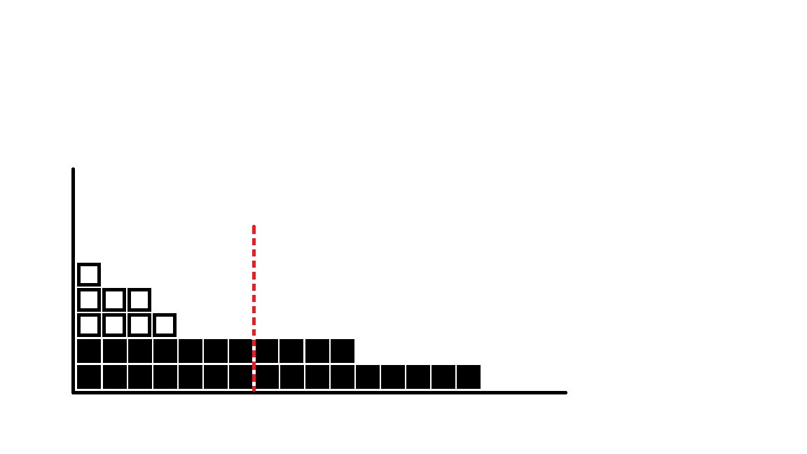
(16)
N = 5
X = { 1, 3, 4, 11, 16 }
Average = 1 + 3 + 4 +11 + 16
5
Average is the typical representation of the group.
N = 5
X = { 1, 3, 4, 11, 16 }
Mean Average Middle = 7
x
35
5
=
=
7
(11)
1 2 3 4 5
(4)
0 1 2 3 4 5 6 7 8 9 10 11 12 13 14 15 16 17 18 19 20 21 22 23 24 25 26 27 28 29 30 31 32 33 34 35
(3)
(1)
0 1 2 3 4 5 6 7 8 9 10 11 12 13 14 15 16
1 2 3 4 5

Slide 62
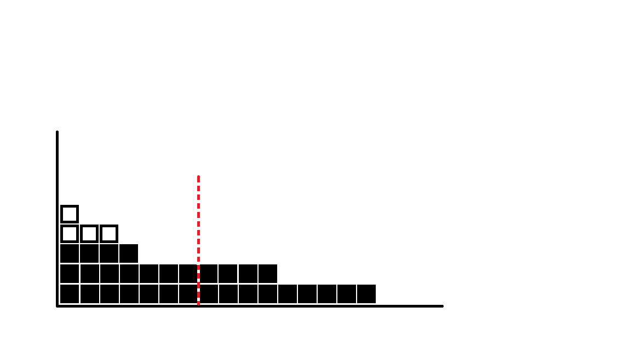
(16)
N = 5
X = { 1, 3, 4, 11, 16 }
Average = 1 + 3 + 4 +11 + 16
5
Average is the typical representation of the group.
N = 5
X = { 1, 3, 4, 11, 16 }
Mean Average Middle = 7
x
35
5
=
=
7
(11)
1 2 3 4 5
(4)
0 1 2 3 4 5 6 7 8 9 10 11 12 13 14 15 16 17 18 19 20 21 22 23 24 25 26 27 28 29 30 31 32 33 34 35
(3)
(1)
0 1 2 3 4 5 6 7 8 9 10 11 12 13 14 15 16
1 2 3 4 5

Slide 63
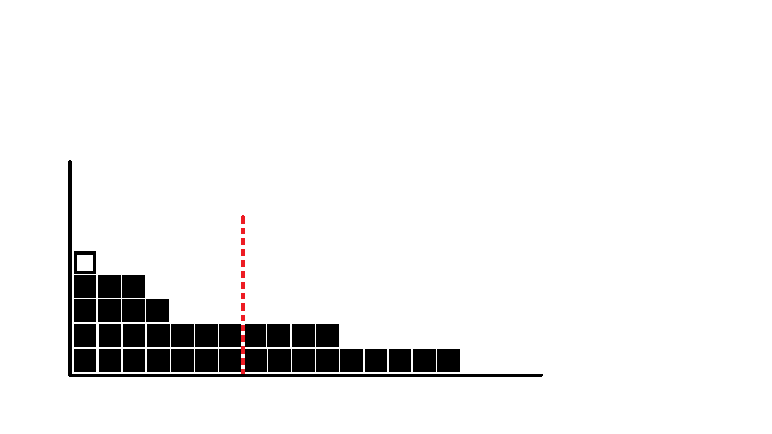
(16)
N = 5
X = { 1, 3, 4, 11, 16 }
Average = 1 + 3 + 4 +11 + 16
5
Average is the typical representation of the group.
N = 5
X = { 1, 3, 4, 11, 16 }
Mean Average Middle = 7
x
35
5
=
=
7
(11)
1 2 3 4 5
(4)
0 1 2 3 4 5 6 7 8 9 10 11 12 13 14 15 16 17 18 19 20 21 22 23 24 25 26 27 28 29 30 31 32 33 34 35
(3)
(1)
0 1 2 3 4 5 6 7 8 9 10 11 12 13 14 15 16
1 2 3 4 5

Slide 64

(16)
N = 5
X = { 1, 3, 4, 11, 16 }
Average = 1 + 3 + 4 +11 + 16
5
Average is the typical representation of the group.
N = 5
X = { 1, 3, 4, 11, 16 }
Mean Average Middle = 7
x
35
5
=
=
7
(11)
1 2 3 4 5
(4)
0 1 2 3 4 5 6 7 8 9 10 11 12 13 14 15 16 17 18 19 20 21 22 23 24 25 26 27 28 29 30 31 32 33 34 35
(3)
(1)
0 1 2 3 4 5 6 7 8 9 10 11 12 13 14 15 16
1 2 3 4 5

Slide 65
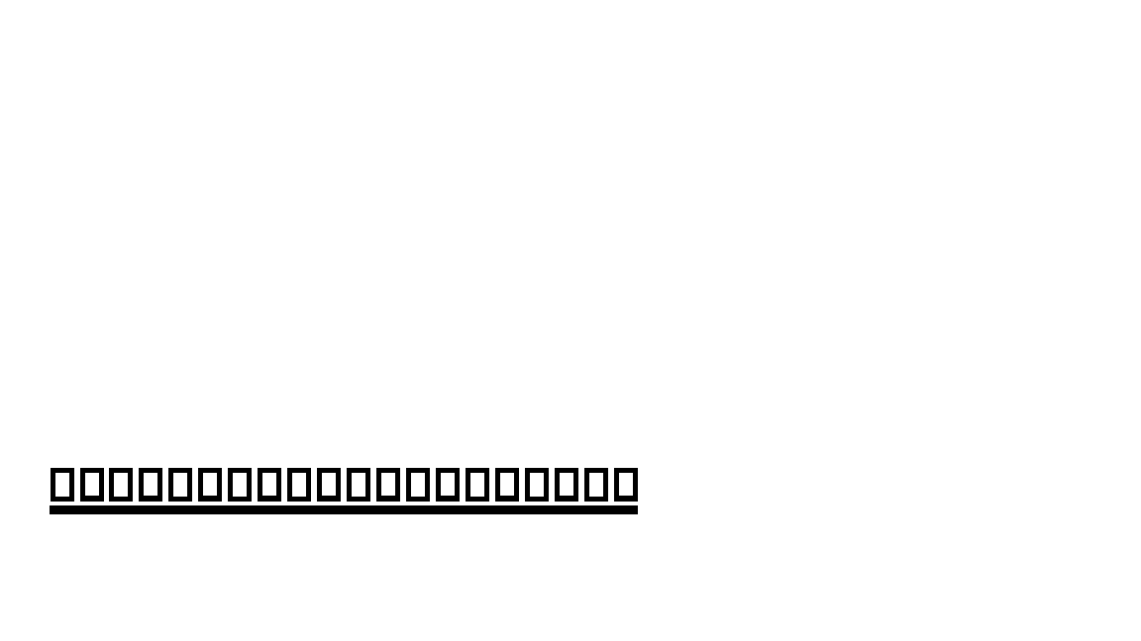
A measure of central tendency shows us the “middleness,” but nothing about width or spread of the other numbers
x
How do the rest of the numbers relate to the /mean/average/middle number?
Variation: How numbers around the mean are related
1 2 3 4 5 6 7 8 9 10 11 12 13 14 15 16 17 18 19 20

Slide 66
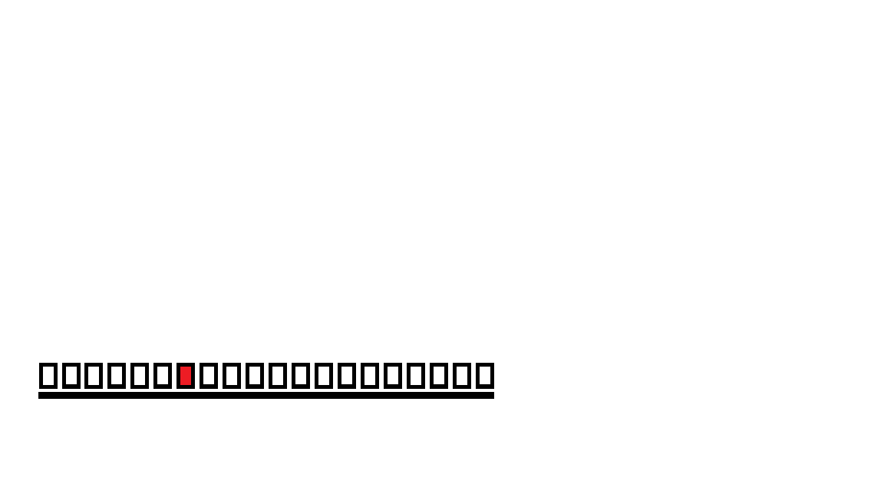
x
= 7
Variance for each number in our distribution 1 =
compared to the mean 3 =
4 =
11 =
16 =
1 2 3 4 5 6 7 8 9 10 11 12 13 14 15 16 17 18 19 20

Slide 67
x
= 7
Variance for each number in our distribution 1 = 6
compared to the mean 3 = 4
4 = 3
11 = 4
16 = 9
1 2 3 4 5 6 7 8 9 10 11 12 13 14 15 16 17 18 19 20

Slide 68
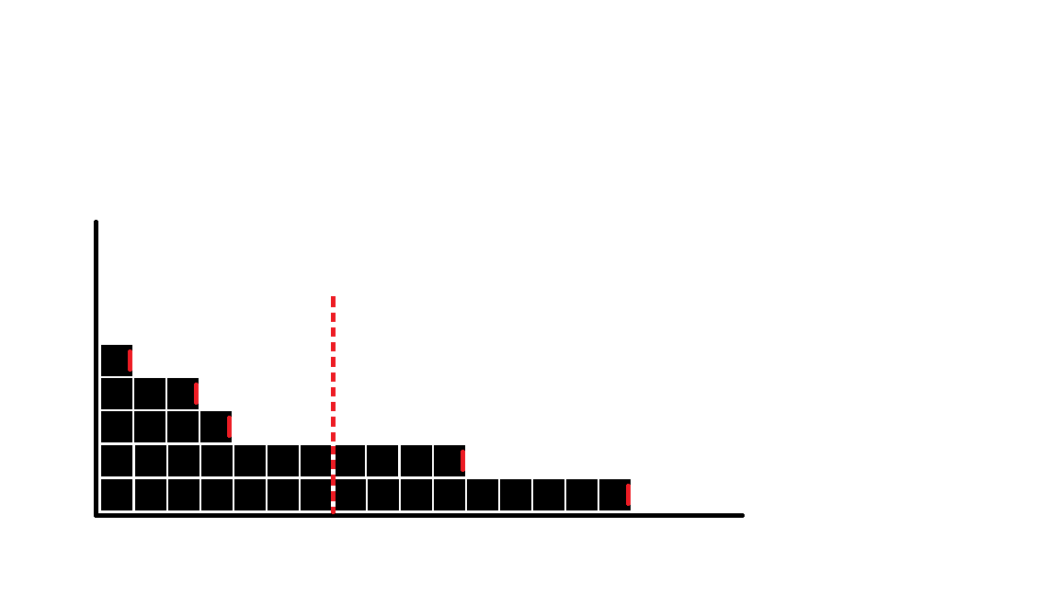
(16)
N = 5
X = { 1, 3, 4, 11, 16 }
Average = 1 + 3 + 4 +11 + 16
5
N = 5
X = { 1, 3, 4, 11, 16 }
= 7
x
35
5
=
=
7
(11)
Mean
(Average)
1 2 3 4 5
(4)
0 1 2 3 4 5 6 7 8 9 10 11 12 13 14 15 16 17 18 19 20 21 22 23 24 25 26 27 28 29 30 31 32 33 34 35
(3)
(1)
0 1 2 3 4 5 6 7 8 9 10 11 12 13 14 15 16
1 2 3 4 5

Slide 69
(16)
N = 5
X = { 1, 3, 4, 11, 16 }
Average = 1 + 3 + 4 +11 + 16
5
Variation how much a value varies from another value
Deviation is a measure of variation
N = 5
X = { 1, 3, 4, 11, 16 }
= 7
x
35
5
=
=
7
(11)
Mean
(Average)
-6
-4
1 2 3 4 5
(4)
-3
(3)
0 1 2 3 4 5 6 7 8 9 10 11 12 13 14 15 16 17 18 19 20 21 22 23 24 25 26 27 28 29 30 31 32 33 34 35
4
9
(1)
0 1 2 3 4 5 6 7 8 9 10 11 12 13 14 15 16
1 2 3 4 5

Slide 70
(16)
N = 5
X = { 1, 3, 4, 11, 16 }
Average = 1 + 3 + 4 +11 + 16
5
Variation how much a value varies from another value
Deviation is a measure of variation
N = 5
X = { 1, 3, 4, 11, 16 }
= 7
x
35
5
=
=
7
(11)
(-)
Mean
(Average)
(+)
-6
-4
1 2 3 4 5
(4)
-3
(3)
0 1 2 3 4 5 6 7 8 9 10 11 12 13 14 15 16 17 18 19 20 21 22 23 24 25 26 27 28 29 30 31 32 33 34 35
4
9
(1)
0 1 2 3 4 5 6 7 8 9 10 11 12 13 14 15 16
1 2 3 4 5

Slide 71
(16)
N = 5
X = { 1, 3, 4, 11, 16 }
Average = 1 + 3 + 4 +11 + 16
5
Variation how much a value varies from another value
Deviation is a measure of variation
N = 5
X = { 1, 3, 4, 11, 16 }
= 7
x
35
5
=
=
7
(11)
(-)
Mean
(Average)
(+)
-6 -4 -3 = -13
4 +9 = 13
-6
1 - 7 = -6
3 - 7 = -4
4 - 7 = -3
11 - 7 = 4
16 - 7 = 9
0
-4
1 2 3 4 5
(4)
-3
(3)
0 1 2 3 4 5 6 7 8 9 10 11 12 13 14 15 16 17 18 19 20 21 22 23 24 25 26 27 28 29 30 31 32 33 34 35
4
9
(1)
0 1 2 3 4 5 6 7 8 9 10 11 12 13 14 15 16
1 2 3 4 5

Slide 72
(16)
N = 5
X = { 1, 3, 4, 11, 16 }
Average = 1 + 3 + 4 +11 + 16
5
Variation how much a value varies from another value
Deviation is a measure of variation
Average Deviation is, well, the average of the sum of deviations.
N = 5
X = { 1, 3, 4, 11, 16 }
= 7
x
35
5
=
=
7
(11)
(-)
Mean
(Average)
(+)
Average Deviation = -6 -4 -3 +4 +9
5
0
5
0
=
=
-6 -4 -3 = -13
4 +9 = 13
-6
1 - 7 = -6
3 - 7 = -4
4 - 7 = -3
11 - 7 = 4
16 - 7 = 9
0
-4
1 2 3 4 5
(4)
-3
(3)
0 1 2 3 4 5 6 7 8 9 10 11 12 13 14 15 16 17 18 19 20 21 22 23 24 25 26 27 28 29 30 31 32 33 34 35
4
9
(1)
0 1 2 3 4 5 6 7 8 9 10 11 12 13 14 15 16
1 2 3 4 5

Slide 73
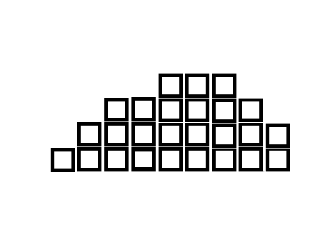
Average Deviation = -6 -4 -3 +4 +9 0
5
= 0
=
5
26

Slide 74
Average Deviation = -6 -4 -3 +4 +9 0
5
= 0
=
5
Because it is how we are manipulating the numbers.
26

Slide 75
Average Deviation = -6 -4 -3 +4 +9 0
5
= 0
=
5
Because it is how we are manipulating the numbers.
Any time you divide something in half, half will fall on one side of the average, half on the other side.
26

Slide 76
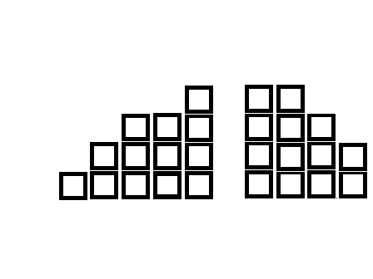
Average Deviation = -6 -4 -3 +4 +9 0
5
= 0
=
5
Because it is how we are manipulating the numbers.
Any time you divide something in half, half will fall on one side of the average, half on the other side.
Average
$$\frac{1}{2}$$
$$\frac{1}{2}$$
(-)
(+)
-13
13
13

Slide 77
Average Deviation = -6 -4 -3 +4 +9 0
5
= 0
=
5
Because it is how we are manipulating the numbers.
Any time you divide something in half, half will fall on one side of the average, half on the other side.
The average is larger than one half and smaller than one half.
Average
$$\frac{1}{2}$$
$$\frac{1}{2}$$
(-)
(+)
-13
13
13

Slide 78
Average Deviation = -6 -4 -3 +4 +9 0
5
= 0
=
5
Because it is how we are manipulating the numbers.
Any time you divide something in half, half will fall on one side of the average, half on the other side.
The average is larger than one half and smaller than one half.
When you take the average away from the smaller half you will have a negative number. When you take the average away from the larger half you will have a positive number.
Average
$$\frac{1}{2}$$
$$\frac{1}{2}$$
(-)
(+)
-13
13
13
1 – 13 = -12
2 – 13 = -11
3 – 13 = -10
4 – 13 = - 9
12 – 13 = - 1

Slide 79
Average Deviation = -6 -4 -3 +4 +9 0
5
= 0
=
5
Because it is how we are manipulating the numbers.
Any time you divide something in half, half will fall on one side of the average, half on the other side.
The average is larger than one half and smaller than one half.
When you take the average away from the smaller half you will have a negative number. When you take the average away from the larger half you will have a positive number.
Average
$$\frac{1}{2}$$
$$\frac{1}{2}$$
(-)
(+)
-13
13
13
1 – 13 = -12 14 – 13 = 1
2 – 13 = -11 15 – 13 = 2
3 – 13 = -10 19 – 13 = 6
4 – 13 = - 9 20 – 13 = 7
12 – 13 = - 1 22 – 13 = 9

Slide 80
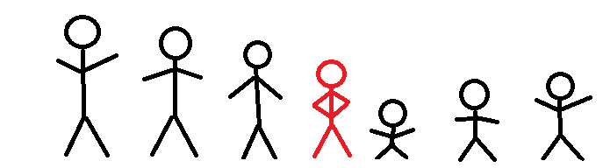
Average Deviation = -6 -4 -3 +4 +9 0
5
= 0
=
5
Because it is how we are manipulating the numbers.
Any time you divide something in half, half will fall on one side of the average, half on the other side.
The average is larger than one half and smaller than one half.
When you take the average away from the smaller half you will have a negative number. When you take the average away from the larger half you will have a positive number.
Average
$$\frac{1}{2}$$
$$\frac{1}{2}$$
(-)
(+)
-13
13
13

Slide 81
Average Deviation = -6 -4 -3 +4 +9 0
5
= 0
=
5
Because it is how we are manipulating the numbers.
Any time you divide something in half, half will fall on one side of the average, half on the other side.
The average is larger than one half and smaller than one half.
When you take the average away from the smaller half you will have a negative number. When you take the average away from the larger half you will have a positive number.
Average
$$\frac{1}{2}$$
$$\frac{1}{2}$$
(-)
(+)
-13
13
13

Slide 82
Stop/Start

Slide 83
So what if we use the absolute value? It would put all of our numbers on the positive side of the number line and not cancel each other out!
1 - 7 = -6 = 6
3 - 7 = -4 = 4
4 - 7 = -3 = 3
11 - 7 = 4 = 4
16 - 7 = 9 = 9
26
26/5 = 5.2

Slide 84
So what if we use the absolute value? It would put all of our numbers on the positive side of the number line and not cancel each other out!
1 - 7 = -6 = 6
3 - 7 = -4 = 4
4 - 7 = -3 = 3
11 - 7 = 4 = 4
16 - 7 = 9 = 9
26
26/5 = 5.2

Slide 85
So what if we use the absolute value? It would put all of our numbers on the positive side of the number line and not cancel each other out!
1 - 7 = -6 = 6
3 - 7 = -4 = 4
4 - 7 = -3 = 3
11 - 7 = 4 = 4
16 - 7 = 9 = 9

Slide 86
So what if we use the absolute value? It would put all of our numbers on the positive side of the number line and not cancel each other out!
∑
1 - 7 = -6 = 6
3 - 7 = -4 = 4
4 - 7 = -3 = 3
11 - 7 = 4 = 4
16 - 7 = 9 = 9
26

Slide 87
So what if we use the absolute value? It would put all of our numbers on the positive side of the number line and not cancel each other out!
∑
1 - 7 = -6 = 6
3 - 7 = -4 = 4
4 - 7 = -3 = 3
11 - 7 = 4 = 4
16 - 7 = 9 = 9
26
26/5 = 5.2
Average Deviation

Slide 88
So what if we use the absolute value? It would put all of our numbers on the positive side of the number line and not cancel each other out!
Sum of Squares = the mean is subtracted from each value, squared, and then added together.
∑
1 - 7 = -6 = 6
3 - 7 = -4 = 4
4 - 7 = -3 = 3
11 - 7 = 4 = 4
16 - 7 = 9 = 9
26
26/5 = 5.2
Average Deviation

Slide 89
So what if we use the absolute value? It would put all of our numbers on the positive side of the number line and not cancel each other out!
Sum of Squares = the mean is subtracted from each value, squared, and then added together.
∑
∑
1 - 7 = -6 = 6
3 - 7 = -4 = 4
4 - 7 = -3 = 3
11 - 7 = 4 = 4
16 - 7 = 9 = 9
26
(1 - 7)² = (-6)² = 36
(3 - 7)² = (-4)² = 16
(4 - 7)² = (-3)² = 9
(11 - 7)² = (4)² = 16
(16 - 7)² = (9)² = 81
158
Sum of Squares (SS)
26/5 = 5.2
Average Deviation

Slide 90
So what if we use the absolute value? It would put all of our numbers on the positive side of the number line and not cancel each other out!
Sum of Squares = the mean is subtracted from each value, squared, and then added together.
∑
∑
Variance = the average of the squared differences from the mean.
1 - 7 = -6 = 6
3 - 7 = -4 = 4
4 - 7 = -3 = 3
11 - 7 = 4 = 4
16 - 7 = 9 = 9
26
(1 - 7)² = (-6)² = 36
(3 - 7)² = (-4)² = 16
(4 - 7)² = (-3)² = 9
(11 - 7)² = (4)² = 16
(16 - 7)² = (9)² = 81
158
158/5 = 31.6
26/5 = 5.2
Average Deviation

Slide 91

So what if we use the absolute value? It would put all of our numbers on the positive side of the number line and not cancel each other out!
Sum of Squares = the mean is subtracted from each value, squared, and then added together.
∑
∑
Variance = the average of the squared differences from the mean.
1 - 7 = -6 = 6
3 - 7 = -4 = 4
4 - 7 = -3 = 3
11 - 7 = 4 = 4
16 - 7 = 9 = 9
26
(1 - 7)² = (-6)² = 36
(3 - 7)² = (-4)² = 16
(4 - 7)² = (-3)² = 9
(11 - 7)² = (4)² = 16
(16 - 7)² = (9)² = 81
158
158/5 = 31.6
Standard Deviation = the squared root of the average squared deviation from the mean (variance).
$\sqrt{31.6}$ = 5.62
26/5 = 5.2
Average Deviation

Slide 92
Sum of Squares = the mean is subtracted from each value, squared, and then added together.
∑
(1 - 7)² = (-6)² = 36
(3 - 7)² = (-4)² = 16
(4 - 7)² = (-3)² = 9
(11 - 7)² = (4)² = 16
(16 - 7)² = (9)² = 81
158
The sum of (+)

Slide 93
Sum of Squares = the mean is subtracted from each value, squared, and then added together.
The squared averages
(1 - 7)² = (-6)² = 36
(3 - 7)² = (-4)² = 16
(4 - 7)² = (-3)² = 9
(11 - 7)² = (4)² = 16
(16 - 7)² = (9)² = 81
158
The sum of (+)

Slide 94
Sum of Squares = the mean is subtracted from each value, squared, and then added together.
The squared averages
(1 - 7)² = (-6)² = 36
(3 - 7)² = (-4)² = 16
(4 - 7)² = (-3)² = 9
(11 - 7)² = (4)² = 16
(16 - 7)² = (9)² = 81
158
After subtracting the mean from the individual averages
The sum of (+)

Slide 95

Sum of Squares = the mean is subtracted from each value, squared, and then added together.
(1 - 7)² = (-6)² = 36
(3 - 7)² = (-4)² = 16
(4 - 7)² = (-3)² = 9
(11 - 7)² = (4)² = 16
(16 - 7)² = (9)² = 81
158
$$\frac{158}{5}=31.6$$
Average Deviation

Slide 96

Sum of Squares = the mean is subtracted from each value, squared, and then added together.
(1 - 7)² = (-6)² = 36
(3 - 7)² = (-4)² = 16
(4 - 7)² = (-3)² = 9
(11 - 7)² = (4)² = 16
(16 - 7)² = (9)² = 81
158
Standard Deviation = the squared root of the average squared deviation from the mean (variance).
$$\frac{158}{5}=31.6$$
Average Deviation
$\sqrt{31.6 }$ = 5.62 = σ

Slide 97

Sum of Squares = the mean is subtracted from each value, squared, and then added together.
(1 - 7)² = (-6)² = 36
(3 - 7)² = (-4)² = 16
(4 - 7)² = (-3)² = 9
(11 - 7)² = (4)² = 16
(16 - 7)² = (9)² = 81
158
The average of the absolute values = 5.2
The average of the sum of squares = 5.62
Standard Deviation = the squared root of the average squared deviation from the mean (variance).
$$\frac{158}{5}=31.6$$
Average Deviation
$\sqrt{31.6 }$ = 5.62 = σ

Slide 98
N
5
X
1
3
4
11
16

Slide 99
N
5
X
1
3
4
11
16
Mean
1
3
4
11
+16
35
35/5
= 7

Slide 100
N
5
X
1
3
4
11
16
Mean
1
3
4
11
+16
35
35/5
= 7
Deviance
1 – 7 = -6
3 – 7 = -4
4 – 7 = -3
11 – 7 = 4
16 – 7 = 9

Slide 101
N
5
X
1
3
4
11
16
Mean
1
3
4
11
+16
35
35/5
= 7
Deviance
1 – 7 = -6
3 – 7 = -4
4 – 7 = -3
11 – 7 = 4
16 – 7 = 9
Sum of Squares
(1 - 7)² = (-6)² = 36
(3 - 7)² = (-4)² = 16
(4 - 7)² = (-3)² = 9
(11 - 7)² = (4)² = 16
(16 - 7)² = (9)² = +81
158

Slide 102
N
5
X
1
3
4
11
16
Mean
1
3
4
11
+16
35
35/5
= 7
Deviance
1 – 7 = -6
3 – 7 = -4
4 – 7 = -3
11 – 7 = 4
16 – 7 = 9
Sum of Squares
(1 - 7)² = (-6)² = 36
(3 - 7)² = (-4)² = 16
(4 - 7)² = (-3)² = 9
(11 - 7)² = (4)² = 16
(16 - 7)² = (9)² = +81
158
Variance
158/5 = 31.6

Slide 103
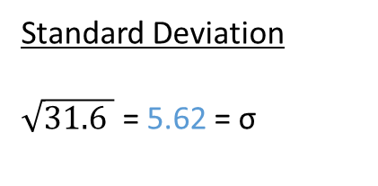
N
5
X
1
3
4
11
16
Mean
1
3
4
11
+16
35
35/5
= 7
Deviance
1 – 7 = -6
3 – 7 = -4
4 – 7 = -3
11 – 7 = 4
16 – 7 = 9
Sum of Squares
(1 - 7)² = (-6)² = 36
(3 - 7)² = (-4)² = 16
(4 - 7)² = (-3)² = 9
(11 - 7)² = (4)² = 16
(16 - 7)² = (9)² = +81
158
Variance
158/5 = 31.6
Standard Deviation
$\sqrt{31.6 }$ = 5.62 = σ

Slide 104
N
5
X
1
3
4
11
16
Mean
1
3
4
11
+16
35
35/5
= 7
Deviance
1 – 7 = -6
3 – 7 = -4
4 – 7 = -3
11 – 7 = 4
16 – 7 = 9
Sum of Squares
(1 - 7)² = (-6)² = 36
(3 - 7)² = (-4)² = 16
(4 - 7)² = (-3)² = 9
(11 - 7)² = (4)² = 16
(16 - 7)² = (9)² = +81
158
Variance
158/5 = 31.6
Standard Deviation
$\sqrt{31.6 }$ = 5.62 = σ
5.62² = 31.6

Slide 105

N
5
X
1
3
4
11
16
Mean
1
3
4
11
+16
35
35/5
= 7
Deviance
1 – 7 = -6
3 – 7 = -4
4 – 7 = -3
11 – 7 = 4
16 – 7 = 9
Sum of Squares
(1 - 7)² = (-6)² = 36
(3 - 7)² = (-4)² = 16
(4 - 7)² = (-3)² = 9
(11 - 7)² = (4)² = 16
(16 - 7)² = (9)² = +81
158
Variance
158/5 = 31.6
Standard Deviation
$\sqrt{31.6 }$ = 5.62 = σ
5.62² = 31.6
x²
Variance
31.6
5.62
Standard Deviation
$$\sqrt{x}$$

Slide 106
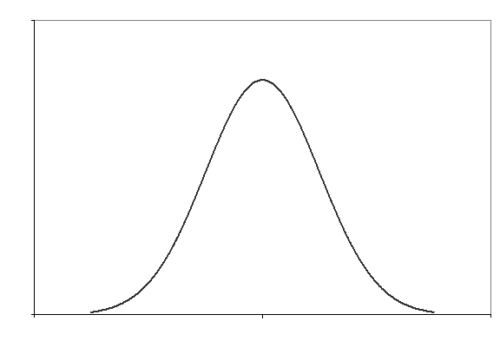
Next up: Distribution

